Slide 1
Mobile Application Development - Day 12
JSON
Gson
Picasso
Glide

Slide 2
JSON
Stands for JavaScript Object Notation
Lightweight format for storing and transportation of data
Easy to understand
Used when data is sent from server to web page

Slide 3
JSON - Rules
Data is in name/value pairs
Data is separated by commas
Curly bracket holds the object
Square bracket holds the array

Slide 4
JSON- Object
{
"name":"John",
"age":30,
"car":null
}

Slide 5
JSON - Object
{
"name":"John",
"age":30,
"cars": {
"car1":"Ford",
"car2":"BMW"
}
}

Slide 6
JSON - Array
[
"Ford",
"BMW",
"Fiat"
]

Slide 7
JSON - Array
{
"name":"John",
"age":30,
"cars":[
"Ford",
"BMW", "Fiat"
]
}

Slide 8
JSON
{ "users": [
{
"id": "1",
"name": "ABC",
"email": "abc@gmail.com",
"contact": {
"mobile1": "0123456789",
"mobile3":"0123456789"
}
}}

Slide 9
GSON
Gson is a Java Library
Used to convert Java Objects into their JSON representation
Used to convert a JSON string to an equivalent Java object

Slide 10
GSON - Gradle Dependency
implementation 'com.google.code.gson:gson:2.8.5

Slide 11
Image Loading Libraries
Picasso
Glide

Slide 12
Picasso
ImageView imageView = (ImageView) findViewById(R.id.my_image_view);
Picasso.get().load("http://i.imgur.com/DvpvklR.png").into(imageView);
Dependency
implementation 'com.squareup.picasso:picasso:2.71828'

Slide 13
Glide
ImageView imageView = (ImageView) findViewById(R.id.my_image_view);
Glide.with(this).load("http://goo.gl/gEgYUd").into(imageView);
Dependency
implementation 'com.github.bumptech.glide:glide:4.11.0'
annotationProcessor 'com.github.bumptech.glide:compiler:4.11.0'

Slide 14
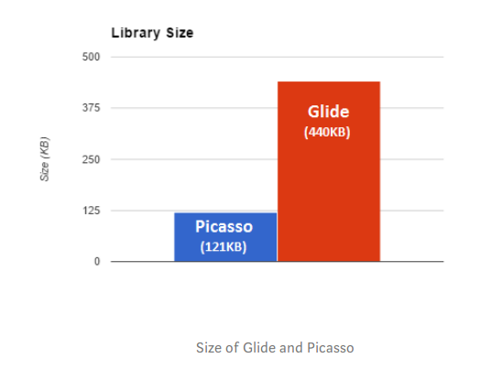
Picasso Vs Glide - Size

Slide 15
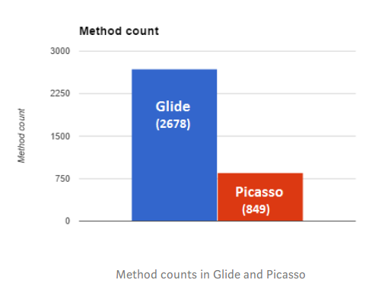
Picasso Vs Glide - Method Count

Slide 16
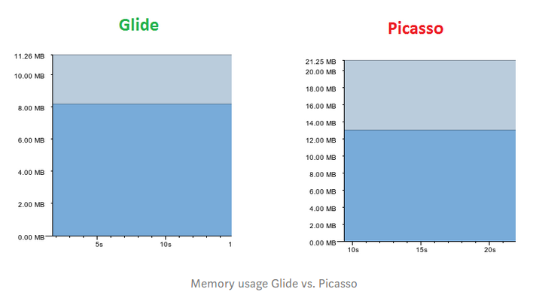
Picasso Vs Glide - Memory

